Slide 1
5.4 Basis And Dimension

Slide 2
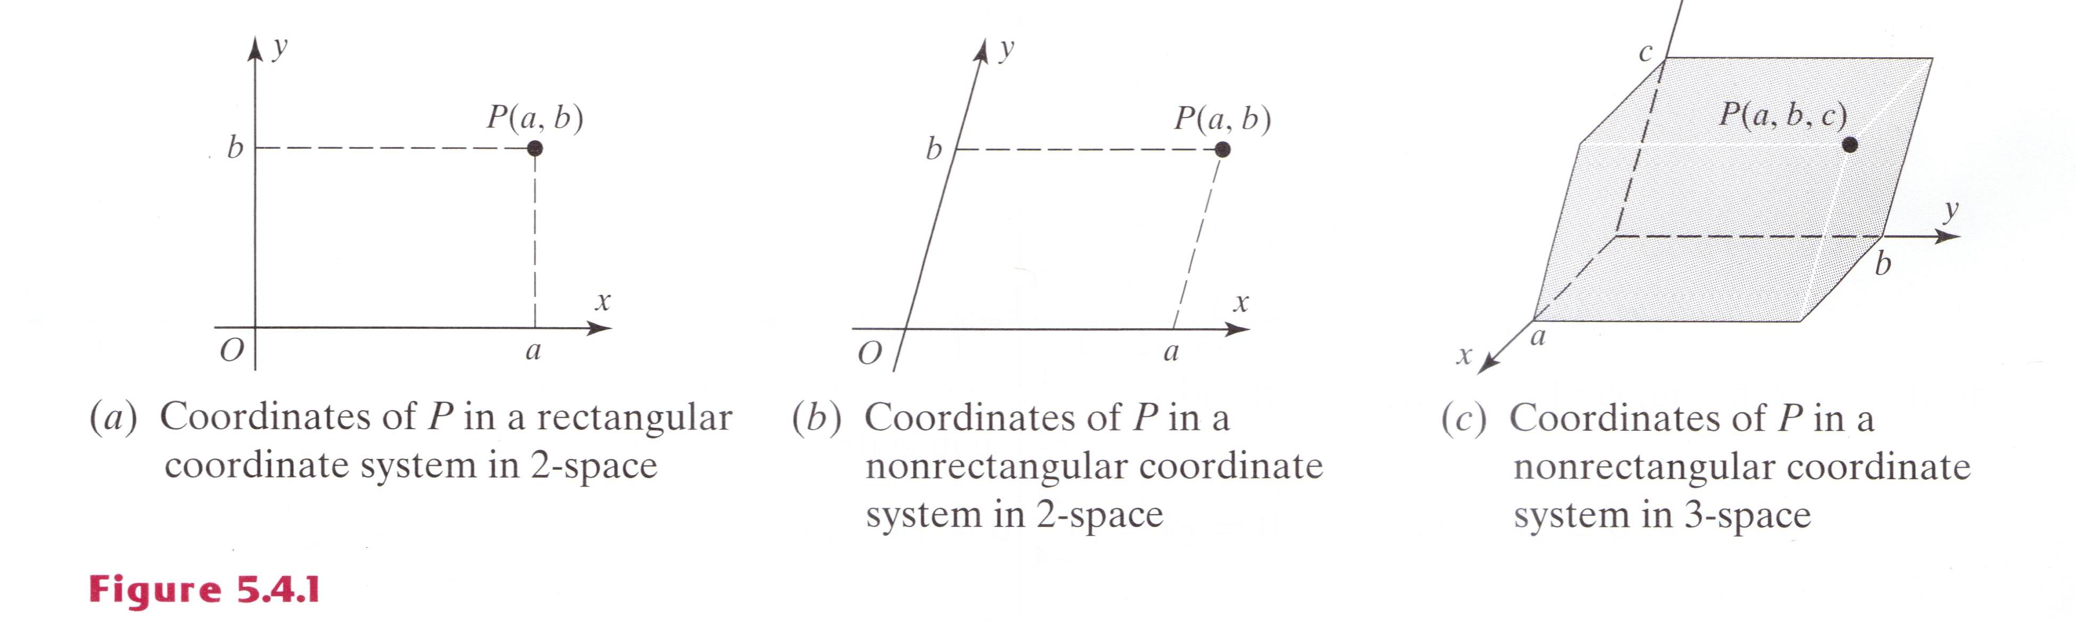
Nonrectangular Coordinate Systems (1/4)
We describe this by saying that the coordinate system establishes a one-to-one correspondence between points in the plane and ordered pairs of real numbers. Although perpendicular coordinate axes are the most common, any two nonparallel lines can be used to define a coordinate system in the plane.

Slide 3
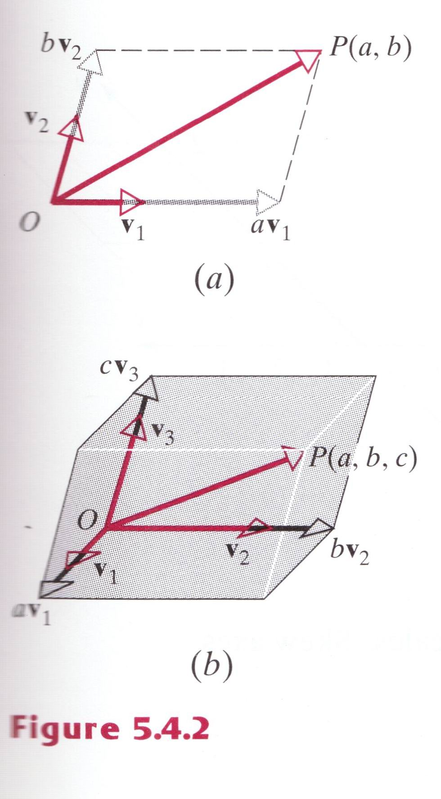


Nonrectangular Coordinate Systems (2/4)
Our first objective in this section is to extend the concept of a coordinate system to general vector. In Figure 5.4.2a, for example, v₁ and v₂ are vectors of length 1 that points in the positive direction of the axis. As illustrated in the figure
Similarly, the coordinates (a, b, c) of the point P in Figure 5.4.1c can be obtained by expressing as a linear combination of the vectors shown in Figure 5.4.2b.

Slide 4
Nonrectangular Coordinate Systems (3/4)
Informally stated, vectors that specify a coordinate system are called “basis vectors” for that system. Although we used basis vectors of length 1 in the preceding discussion, we shall see in a moment that this is not essential – nonzero vectors of any length will suffice.

Slide 5
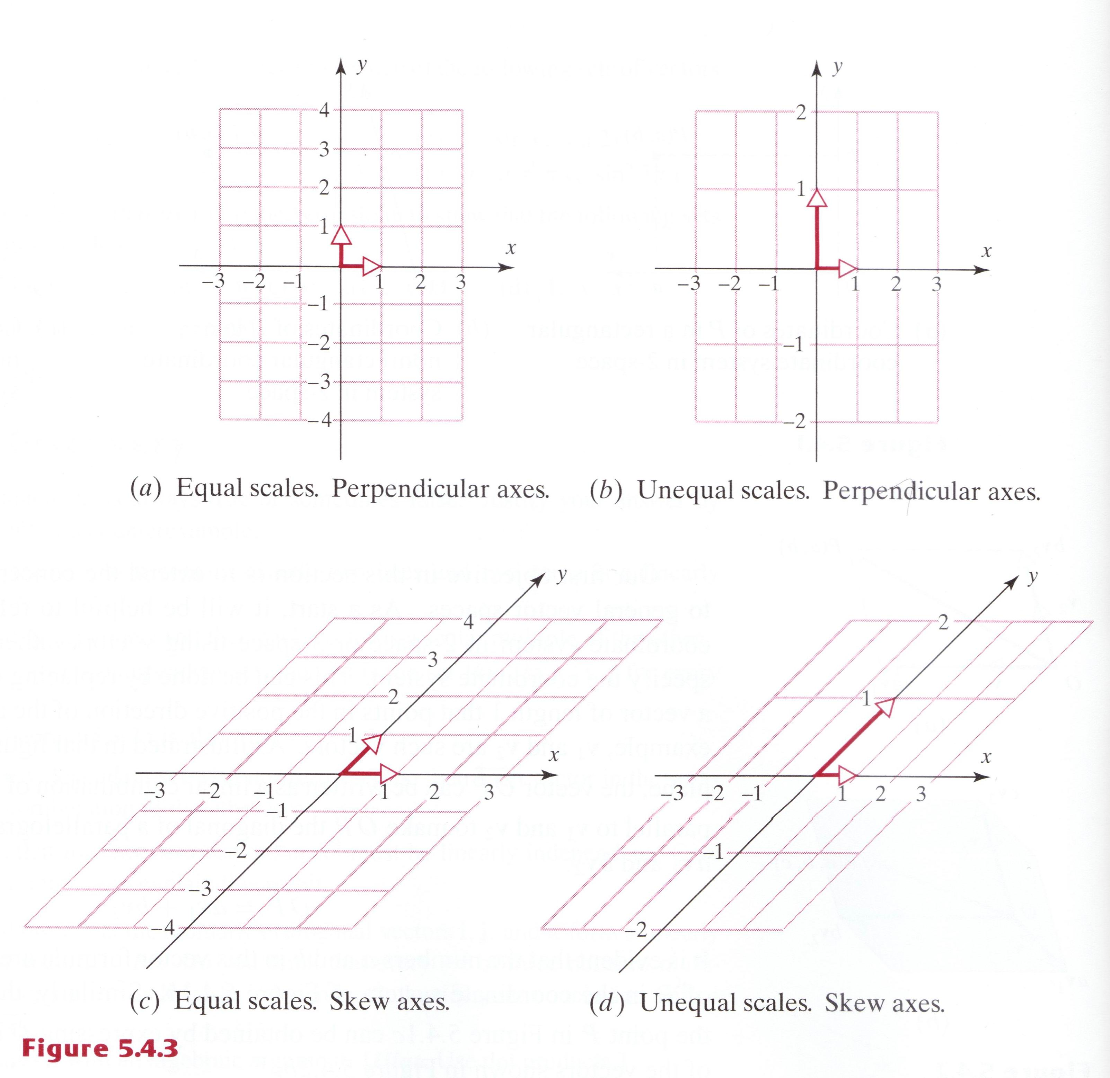
Nonrectangular Coordinate Systems (4/4)

Slide 6
Definition
If V is any vector space and S={v₁, v₂, …,v_{n}} is a set of vectors in V, then S is called a basis for V if the following two conditions hold:
S is linearly independent.
S spans V.

Slide 7
Theorem 5.4.1
Uniqueness of Basis Representation
If S={v₁, v₂, …,v_{n}} is a basis for a vector space V, then every vector v in V can be expressed in the form v=c₁v₁+c₂v₂+…+c_{n}v_{n} in exactly one way.

Slide 8
Coordinates Relative to a Basis
If S={v₁, v₂, …,v_{n}} is a basis for a vector space V, and
v=c₁v₁+c₂v₂+…+c_{n}v_{n}
is the expression for a vector v in terms of the basis S, then the scalars c₁, c₂, …, c_{n}, are called the coordinates of v relative to the basis S. The vector (c₁, c₂, …, c_{n}) in R_{n} constructed from these coordinates is called the coordinate vector of v relative to S; it is denoted by
(v)_{s}=(c₁, c₂, …, c_{n})

Slide 9
Remark
It should be noted that coordinate vectors depend not only on the basis S but also on the order in which the basis vectors are written; a change in the order of the basis vectors results in a corresponding change of order for the entries in the coordinate vector.

Slide 10
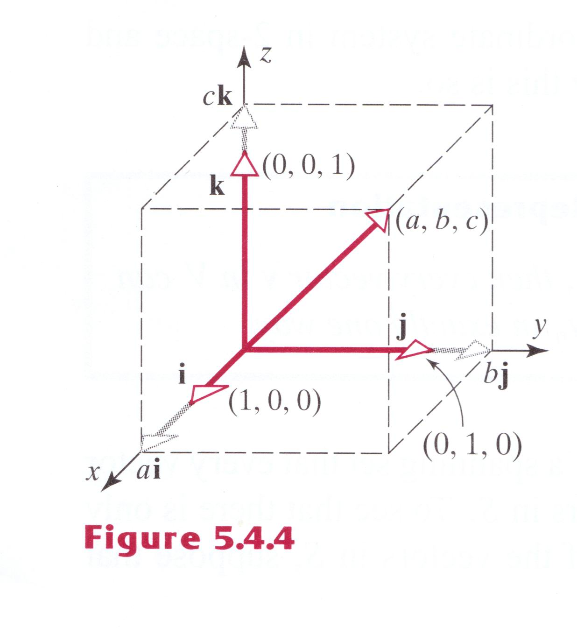
Example 1
Standard Basis for R³
Suppose i=(1, 0, 0), j=(0, 1, 0),and k=(0, 0, 1),
S={i, j, k} is a linearly independent set in R³. This set also spans R³ since any vector v=(a, b, c) in R³ can be written as
v=(a, b, c)=a(1, 0, 0)+b(0, 1, 0)+c(0, 0, 1)=ai+bj+ck (1)
Thus, S is a basis for R³; it is called the standard basis for R³. Looking at the coefficients of i, j, and k in (1), if follows that the coordinates of v relative to the standard basis are a, b, and c, so
(v)_{s}=(a, b, c)
Comparing this result to (1) we see that
v=(v)_{s}

Slide 11
Example 2
Standard Basis for R^{n}
If e₁=(1, 0, 0, …, 0), e₂=(0, 1, 0, …, 0), …, e_{n}=(0, 0, 0, …, 1)
then
S={e₁, e₂, …, e_{n}}
is a linearly independent set in R^{n}. Moreover, this set also spans R^{n} since any vector v=(v₁, v₂, …, v_{n}) in R^{n} can be written as
V=v₁e₁+v₂e₂+…+v_{n}e_{n} (2)
Thus, S is a basis for R^{n}; it is called the standard basis for R^{n}. It follows from (2) that the coordinates of v=(v₁, v₂, …, v_{n}) relative to the standard basis are v₁, v₂, …, v_{n}, so
(v)_{s}=(v₁, v₂, …, v_{n})
As in Example 1, we have v= (v)_{s}, so a vector v and its coordinate vector relative to the standard basis for R^{n} are the same.

Slide 12
Example 3
Demonstrating That a Set of Vectors Is a Basis (1/3)
Let v₁=(1, 2, 1), v₂=(2, 9, 0), and v₃=(3, 3, 4). Show that the set S={v₁, v₂, v₃} is a basis for R³.
Solution.
To show that the set S spans R³, we must show that an arbitrary vector b=(b₁, b₂, b₃) can be expressed as a linear combination
b=c₁v₁+c₂v₂+c₃v₃
of the vectors in S. Expressing this equation in terms of components gives
(b₁, b₂, b₃)=c₁(1, 2, 1)+c₂(2, 9, 0)+c₃(3, 3, 4)
or, on equating corresponding components,
c₁+2c₂+3c₃=b₁
2c₁+9c₂+3c₃=b₂ (3)
c₁ +4c₃=b₃

Slide 13
Example 3
Demonstrating That a Set of Vectors Is a Basis (2/3)
Thus, to show that S spans R³, we must demonstrate that system (3) has a solution for all choices of b=(b₁, b₂, b₃).
To prove that S is linearly dependent, we must show that the only solution of
c₁v₁+c₂v₂+c₃v₃=0 (4)
is c₁=c₂=c₃=0. As above, if (4) is expressed in terms of components, the verification of independence reduces to showing that the homogeneous system
c₁+2c₂+3c₃=0
2c₁+9c₂+3c₃=0 (5)
c₁ +4c₃=0
has only the trivial solution. Observe that system (3) and (5) have the same coefficient matrix.

Slide 14
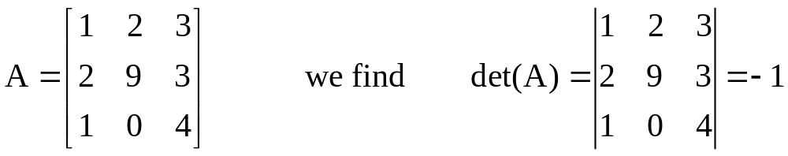
Example 3
Demonstrating That a Set of Vectors Is a Basis (3/3)
Thus, by parts (b), (e), and (g) of Theorem 4.3.4, we can simultaneously prove that S is linearly independent and spans R³ by demonstrating that in systems (3) and (5) the matrix of coefficients has a nonzero determinant. From
and so S is a basis for R³.

Slide 15
Example 4
Representing a Vector Using Two Bases (1/2)
Let S={v₁, v₂, v₃} be the basis for R3 in the preceding example.
Find the coordinate vector of v=(5, -1, 9) with respect to S.
Find the vector v in R3 whose coordinate vector with respect to the basis S is (v)_{s}=(-1, 3, 2).
Solution (a).
We must find scalars c₁, c₂, c₃ such that
v=c₁v₁+c₂v₂+c₃v₃
or, in terms of components,
(5, -1, 9)=c₁(1, 2, 1)+c₂(2, 9, 0)+c₃(3, 3, 4)
Solving this, we obtaining c₁=1, c₂=-1, c₃=2. Therefore,
(v)_{s}=(-1, 3, 2).

Slide 16
Example 4
Representing a Vector Using Two Bases (2/2)
Solution (b).
Using the definition of the coordinate vector (v)_{s}, we obtain
v=(-1)v₁+3v₂+2v₃
=(11, 31, 7).

Slide 17
Example 5
Standard Basis for P_{n}
Show that S={1, x, x², …, x^{n}} is a basis for the vector space P_{n} of polynomials of the form a₀+a₁x+…+a_{n}x^{n}.
Find the coordinate vector of the polynomial p=a₀+a₁x+a₂x² relative to the basis S={1, x, x²}for P₂.
Solution (a).
We showed that S spans P_{n} in Example 11 of Section 5.2, and we showed that S is a linearly independent set in Example 5.3. Thus, S is a basis for P_{n}; it is called the standard basis for P_{n}.
Solution (b).
The coordinates of p=a₀+a₁x+a₂x² are the scalar coefficients of the basis vectors 1, x, and x², so (p)_{s}=(a₀, a₁, a₂).

Slide 18
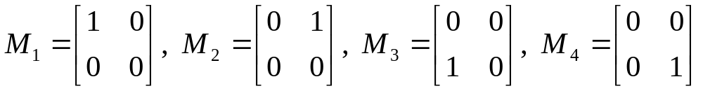
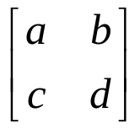
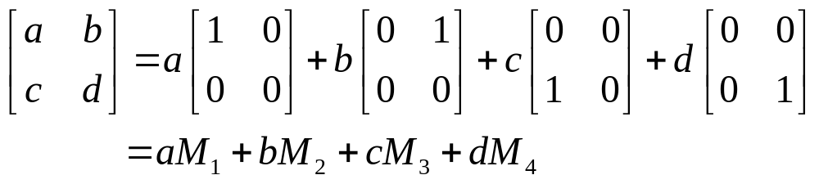
Example 6
Standard Basis for M_{mn} (1/2)
Let
The set S={M₁, M₂, M₃, M₄} is a basis for the vector space M₂₂ of 2×2 matrices. To see that S spans M₂₂, note that an arbitrary vector (matrix)
can be written as
To see that S is linearly independent, assume
aM₁+bM₂+cM₃+dM₄=0

Slide 19
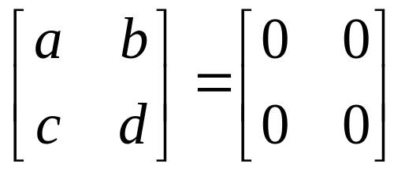
Example 6
Standard Basis for M_{mn} (2/2)
It follows that
Thus, a=b=c=d=0, so S is linearly independent. The basis S in this example is called the standard basis for M₂₂. More generally, the standard basis for M_{mn} consists of the mn different matrices with a single 1 and zeros for the remaining entries.

Slide 20
Example 7
Basis for the Subspace span(S)
If S={v₁, v₂, …,v_{n}} is a linearly independent set in a vector space V, then S is a basis for the subspace span(S) since the set S span span(S) by definition of span(S).

Slide 21
Definition
A nonzero vector V is called finite-dimensional if it contains a finite set of vector {v₁, v₂, …,v_{n}} that forms a basis. If no such set exists, V is called infinite-dimensional. In addition, we shall regard the zero vector space to be finite-dimensional.

Slide 22
Example 8
Some Finite- and Infinite- Dimensional Spaces
By Example 2, 5, and 6, the vector spaces R^{n}, P_{n}, and M_{mn} are finite-dimensional. The vector spaces F(-∞, ∞), C(-∞, ∞), C^{m}(-∞, ∞), and C∞(-∞, ∞) are infinite-dimensional.

Slide 23
Theorem 5.4.2
Let V be a finite-dimensional vector space and {v₁, v₂, …,v_{n}} any basis.
If a set has more than n vector, then it is linearly dependent.
If a set has fewer than n vector, then it does not span V.

Slide 24
Theorem 5.4.3
All bases for a finite-dimensional vector space have the same number of vectors.

Slide 25
Definition
The dimension of a finite-dimensional vector space V, denoted by dim(V), is defined to be the number of vectors in a basis for V. In addition, we define the zero vector space to have dimension zero.

Slide 26
Remark
From here on we shall follow a common convention of regarding the empty set to be a basis for the zero vector space. This is consistent with the preceding definition, since the empty set has no vectors and the zero space has dimension zero.

Slide 27
Example 9
Dimensions of Some Vector Spaces
dim(R^{n})=n [The standard basis has n vectors (Example 2).]
dim(P_{n})=n+1 [The standard basis has n+1 vectors (Example 5).]
dim(M_{mn})=mn [The standard basis has mn vectors (Example 6).]

Slide 28
Example 10
Dimension of a Solution Space (1/2)
Determine a basis for and the dimension of the solution space of the homogeneous system
2x₁+2x₂- x₃ +x₅=0
-x₁+ x₂+2x₃ -3x₄+x₅=0
x₁+ x₂- 2x₃ -x₅=0
x₃ + x₄+ x₅=0
In Example 7 of Section 1.2 it was shown that the general solution of the given system is
x₁=-s-t, x₂=s, x₃=-t, x₄=0, x₅=t
Therefore, the solution vectors can be written as

Slide 29
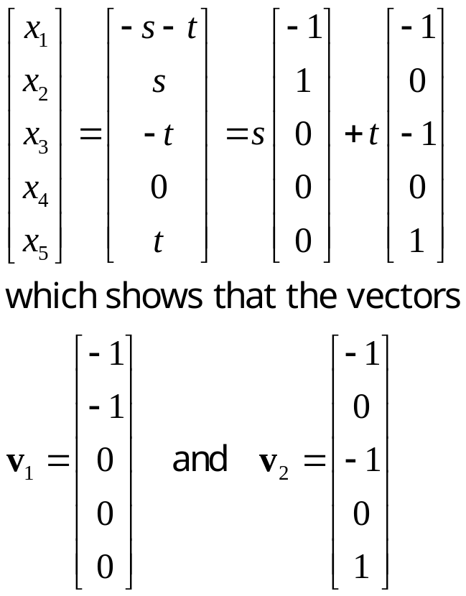
Example 10
Dimension of a Solution Space (2/2)
span the solution space. Since they are also linearly independent, {v₁, v₂} is a basis , and the solution space is two-dimensional.

Slide 30
Theorem 5.4.4
Plus/Minus Theorem
Let S be a nonempty set of vectors in a vector space V.
If S is a linearly independent set, and if v is a vector in V that is outside of span(S), then the set S∪{v} that results by inserting v into S is still linearly independent.
If v is a vector in S that is expressible as a linear combination of other vectors in S, and if S-{v} denotes the set obtained by removing v from S, then S and S-{v} span the same space; that is ,
span(S)=span(S-{v})

Slide 31
Theorem 5.4.5
If V is an n-dimensional vector space, and if S is a set in V with exactly n vectors, then S is a basis for V if either S spans V or S is linearly independent.

Slide 32
Example 11
Checking for a Basis
Show that v₁=(-3, 7) and v₂=(5, 5) form a basis for R² by inspection.
Show that v₁=(2, 0, 1) , v₂=(4, 0, 7), v₃=(-1, 1, 4) form a basis for R³ by inspection.
Solution (a).
Since neither vector is a scalar multiple of the other, the two
vectors form a linear independent set in the two-dimensional
space R², and hence form a basis by Theorem 5.4.5.
Solution (b).
The vectors v₁ and v₂ form a linearly independent set in the
xy-plane. The vector v₃ is outside of the xy-plane, so the set
{v₁, v₂ , v₃} is also linearly independent. Since R³ is three-
dimensional, Theorem 5.4.5 implies that {v₁, v₂ , v₃} is a
basis for R³.

Slide 33
Theorem 5.4.6
Let S be finite set of vectors in a finite-dimensional vector space V.
If S spans V but is not a basis for V, then S can be reduced to a basis for V by removing appropriate vectors from S.
If S is a linearly independent set that is not already a basis for V, then S can be enlarged to a basis for V by inserting appropriate vectors into S.

Slide 34
Theorem 5.4.7
If W is a subspace of a finite-dimensional vector space V, then dim(W)≦dim(V); moreover, if dim(W)=dim(V), then W=V.

Slide 35
5.5 Row Space, Column, Space, And Nullspace

Slide 36
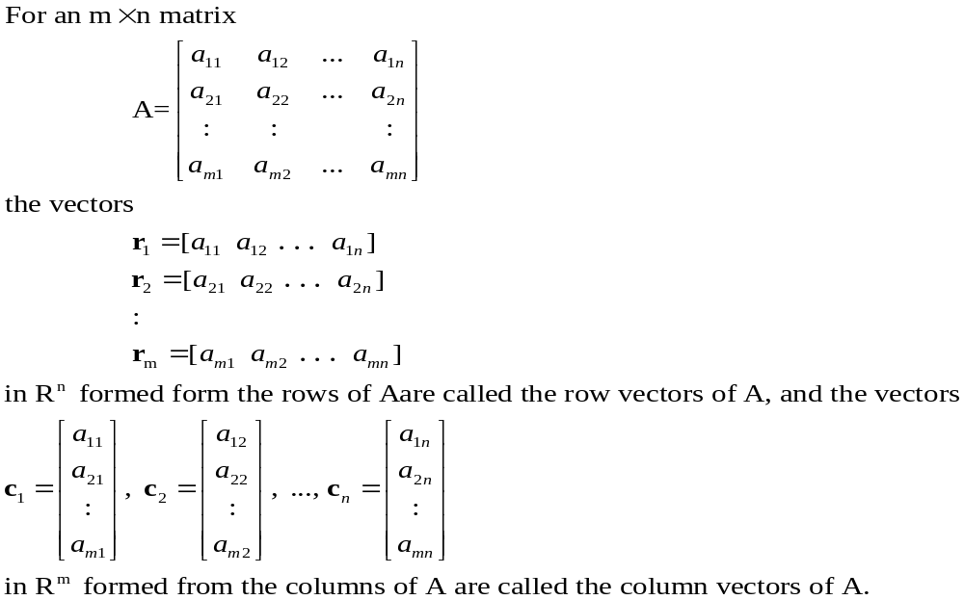
Definition

Slide 37
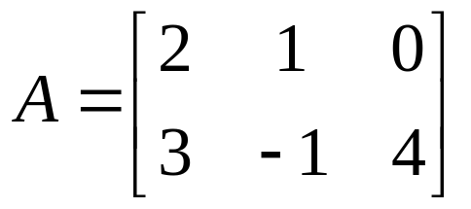
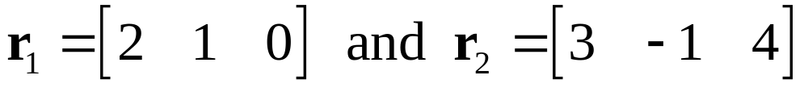
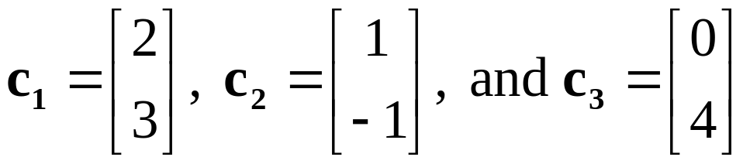
Example 1
Row and Column Vectors in a 2×3 Matrix
Let
The row vectors of A are
and the column vectors of A are

Slide 38
Definition
If A is an m×n matrix, then the subspace of R^{n} spanned by the row vectors of A is called the row space of A, and the subspace of R^{m} spanned by the column vectors is called the column space of A. The solution space of the homogeneous system of equation Ax=0, which is a subspace of R^{n}, is called the nullsapce of A.

Slide 39
Theorem 5.5.1
A system of linear equations Ax=b is consistent if and only if b is in the column space of A.

Slide 40
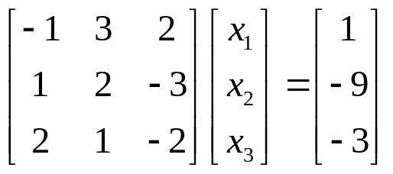
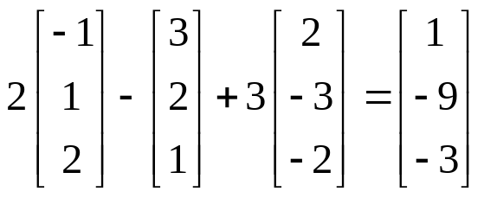
Example 2
A Vector b in the Column Space of A
Let Ax=b be the linear system
Show that b is in the column space of A, and express b as a linear combination of the column vectors of A.
Solution.
Solving the system by Gaussian elimination yields
x₁=2, x₂=-1, x₃=3
Since the system is consistent, b is in the column space of A. Moreover, it follows that

Slide 41
Theorem 5.5.2
If x₀ denotes any single solution of a consistent linear system Ax=b, and if v₁, v₂, …, v_{k} form a basis for the nullspace of A, that is , the solution space of the homogeneous system Ax=0, then every solution of Ax=b can be expressed in the form
x= x₀+c₁v₁+c₂v₂+…+c_{k}v_{k} (3)
And, conversely, for all choices of scalars c₁, c₂, …, c_{k} the vector x in this formula is a solution of Ax=b.

Slide 42
General and Particular Solutions
There is some terminology associated with Formula (3). The vector x₀ is called a particular solution of Ax=b. The expression x₀+c₁v₁+c₂v₂+…+c_{k}v_{k} is called the general solution of Ax=b, and the expression is called the general solution of Ax=0. With this terminology, Formula (3) states, the general solution of Ax=b is the sum of any particular solution of Ax=b and the general solution of Ax=0.

Slide 43
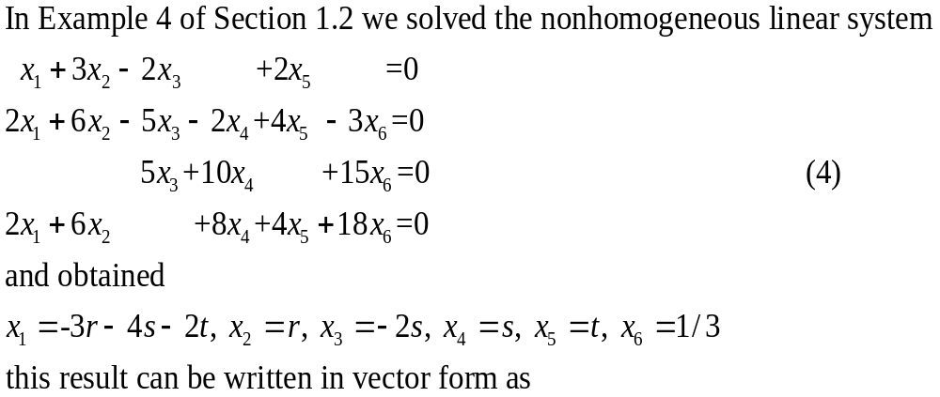

Example 3
General Solution of a Linear System Ax=b (1/2)

Slide 44
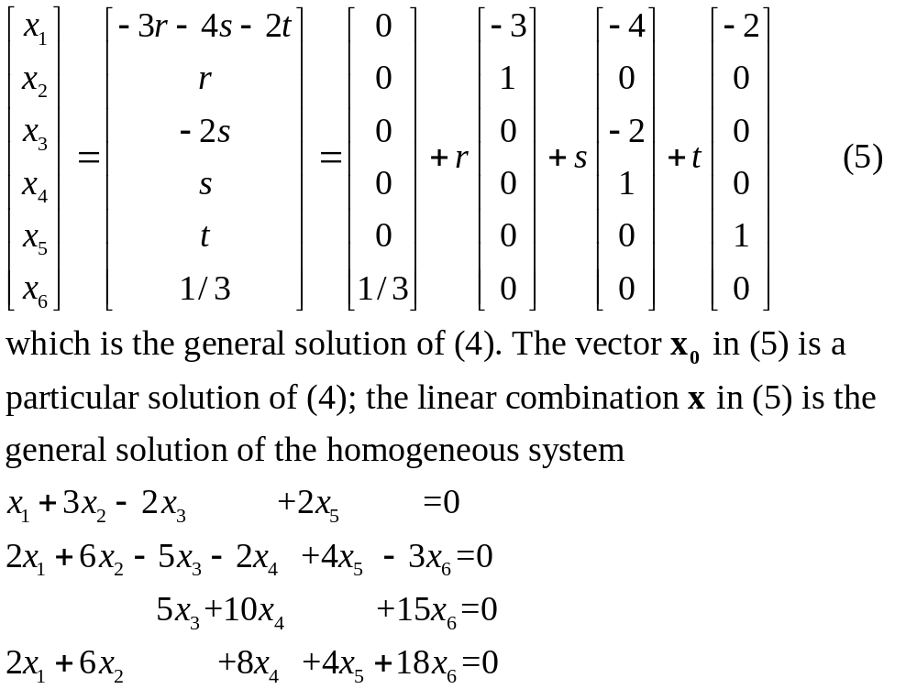
Example 3
General Solution of a Linear System Ax=b (2/2)

Slide 45
Theorem 5.5.3
Elementary row operations do not change the nullspace of a matrix.

Slide 46
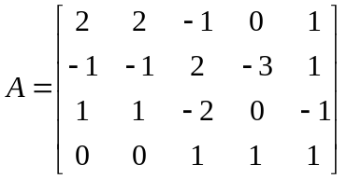
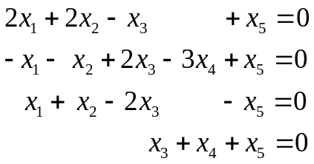
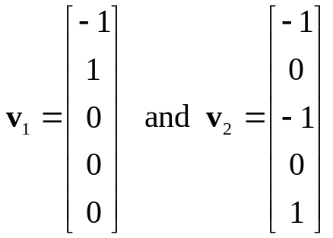
Example 4
Basis for Nullspace
Find a basis for the nullspace of
Solution.
The nullspace of A is the solution space of the homogeneous system
In Example 10 of Section 5.4 we showed that the vectors
Form a basis for this space.

Slide 47
Theorem 5.5.4
Elementary row operations do not change the row space of a matrix.

Slide 48
Theorem 5.5.5
If A and B are row equivalent matrices, then:
A given set of column vectors of A is linearly independent if and only if the corresponding column vectors of B are linearly independent.
A given set of column vectors of A forms a basis for the column space of A if and only if the corresponding column vectors of B form a basis for the column space of B.

Slide 49
Theorem 5.5.6
If a matrix R is in row echelon form, then the row vectors with the leading 1’s (i.e., the nonzero row vectors) form a basis for the row space of R, and the column vectors with the leading 1’s of the row vectors form a basis for the column space of R.

Slide 50
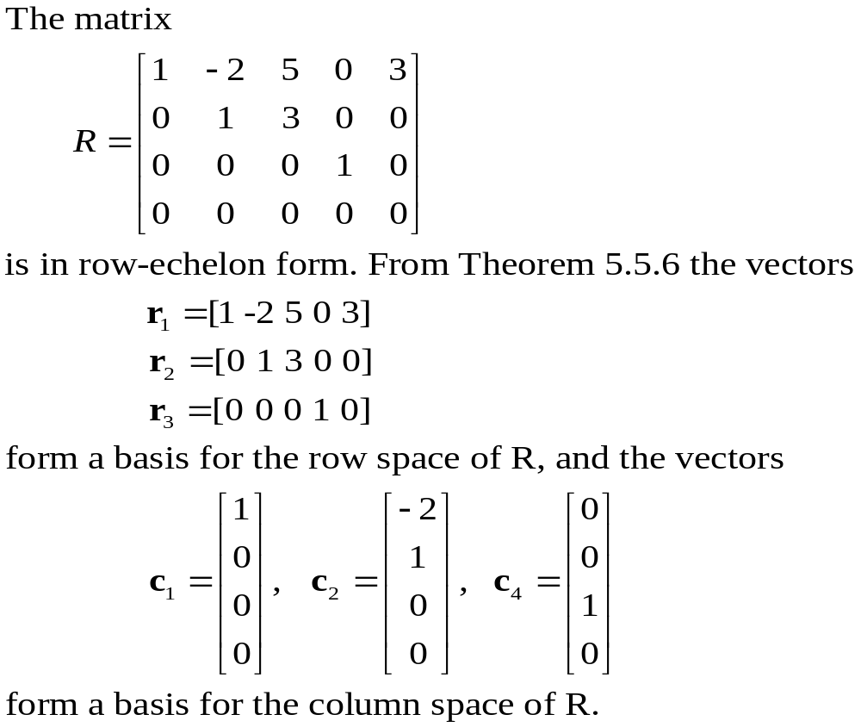
Example 5
Bases for Row and Column Spaces

Slide 51
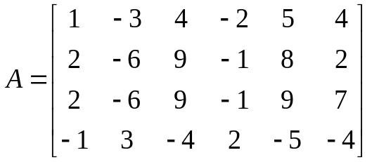
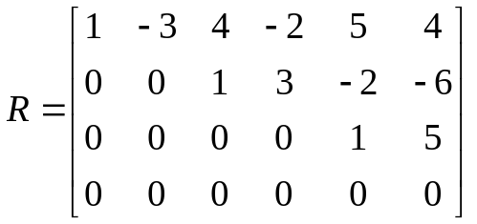
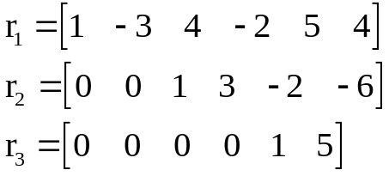
Example 6
Bases for Row and Column Spaces (1/2)
Find bases for the row and column spaces of
Solution.
Reducing A to row-echelon form we obtain
By Theorem 5.5.6 the nonzero row vectors of R form a basis for row space of R, and hence form a basis for the row space of A. These basis vectors are

Slide 52
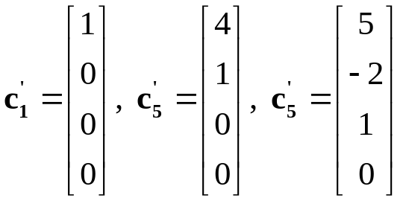
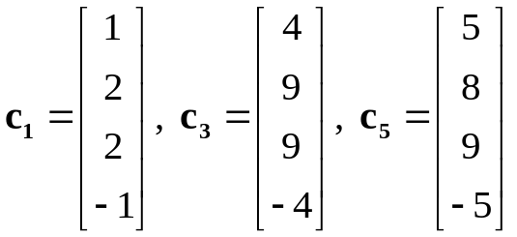
Example 6
Bases for Row and Column Spaces (2/2)
By theorem 5.5.5b we can find a set of column vectors of R that forms a basis for the column space of R, then the corresponding column vectors of A will form a basis for the column space of A.
The first, third, and fifth columns of R contain the leading 1’s of the row vector , so
Form a basis for the column space of R; thus
Form a basis for the column space of A.

Slide 53
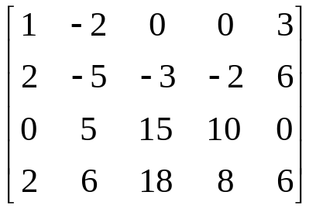
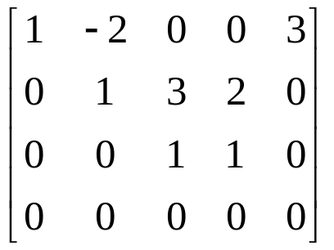
Example 7
Basis for a Vector Space Using Row Operations (1/2)
Find a basis for the space spanned by the vectors
v₁=(1, -2, 0, 0, 3), v₂=(2, -5, -3, -2, 6), v₃=(0, 5, 15, 10, 0), v₄=(2, 6, 18, 8, 6)
Solution.
Except for a variation in notation, the space spanned by these vectors is row space of the matrix
Reducing this matrix to row-echelon form we obtain

Slide 54
Example 7
Basis for a Vector Space Using Row Operations (2/2)
The nonzero row vectors in this matrix are
w₁=(1, -2, 0, 0, 3), w₂=(0, 1, 3, 2, 0), w₃=(0, 0, 1, 1, 0)
These vectors form a basis for the row space and consequently form a basis for the subspace of R⁵ spanned by v₁, v₂, v₃, and v₄.

Slide 55
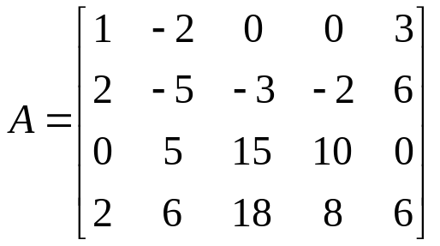
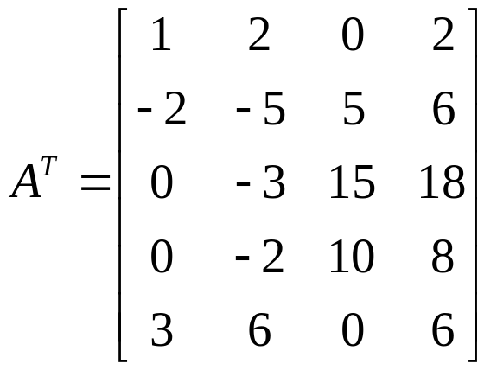
Example 8
Basis for the Row Space of a Matrix (1/2)
Find a basis for the row space of
Consisting entirely of row vectors from A.
Solution.
Transposing A yields

Slide 56
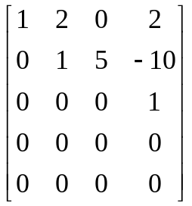
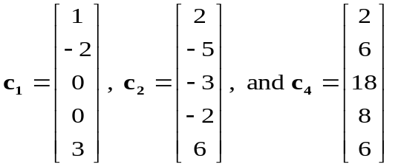
Example 8
Basis for the Row Space of a Matrix (2/2)
Reducing this matrix to row-echelon form yields
The first, second, and fourth columns contain the leading 1’s, so the corresponding column vectors in A^{T} form a basis for the column space of ; these are
Transposing again and adjusting the notation appropriately yields the basis vectors
r₁=[1 -2 0 0 3], r₂=[2 -5 -3 -2 6], and r₃=[2 -5 -3 -2 6]
for the row space of A.

Slide 57
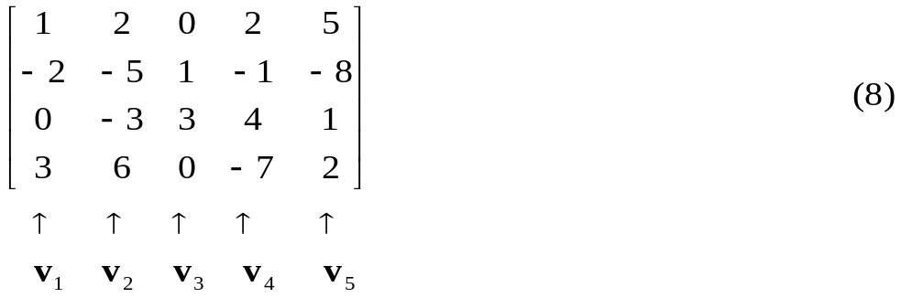
Example 9
Basis and Linear Combinations (1/3)
Find a subset of the vectors
v₁=(1, -2, 0, 3), v₂=(2, -5, -3, 6), v₃=(0, 1, 3, 0), v₄=(2, -1, 4, -7), v₅=(5, -8, 1, 2)
that forms a basis for the space spanned by these vectors.
Express each vector not in the basis as a linear combination of the basis vectors.
Solution (a).
We begin by constructing a matrix that has v₁, v₂, …, v₅ as its column vectors:

Slide 58
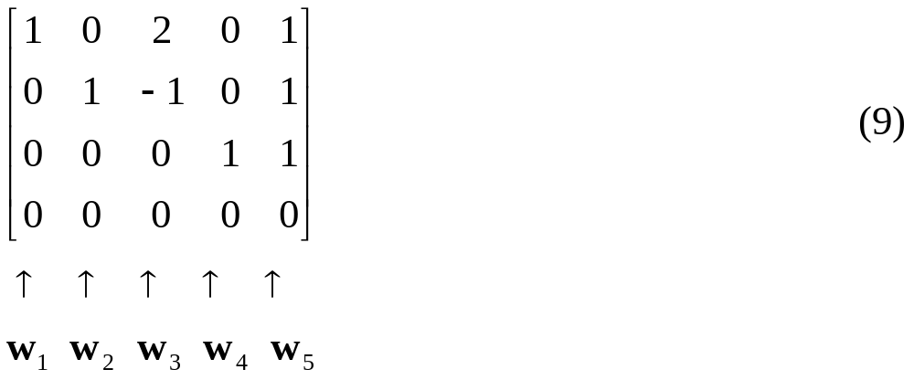
Example 9
Basis and Linear Combinations (2/3)
Reducing the matrix to reduced row-echelon form and denoting the column vectors of the resulting matrix by w₁, w₂, …, and w₅ yields
The leading 1’s occur in column 1, 2, and 4, so that by Theorem 5.5.6
{w₁, w₂, w₄}
is a basis for the column space of (9) and consequently
{v₁, v₂, v₄}
is a basis for the column space of (9).

Slide 59
Example 9
Basis and Linear Combinations (3/3)
Solution (b).
We shall express w₃ as a linear combination of w₁ and w₂, and we shall express w₅ as a linear combination of w₁, w₂, and w₄. By inspection of (9), these linear combination are
w₃=2w₁- w₂
w₃=w₁+w₂+w₄
We call these the dependency equations. The corresponding relationship in (8) are
v₃=2v₁-v₂
v₃=v₁+v₂+v₄

Slide 60
5.6 Rank And Nullity

Slide 61
Theorem 5.6.1
If A is any matrix, then the row space and column space of A have the same dimension.

Slide 62
Definition
The common dimension of the row and column space of a matrix A is called the rank of A and is denoted by rank(A); the dimension of the nullspace of a is called the nullity of A and is denoted by nullity(A).

Slide 63
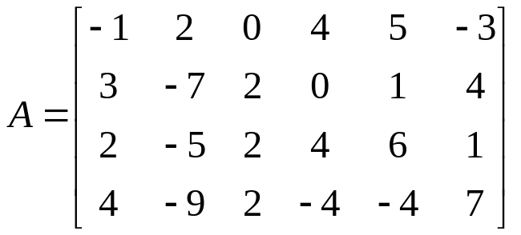
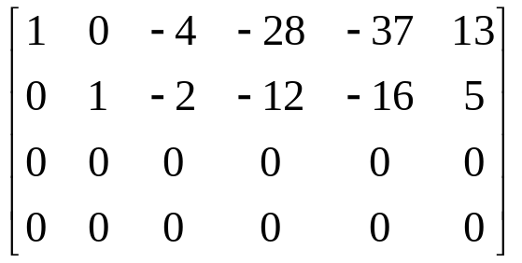
Example 1
Rank and Nullity of a 4×6 Matrix (1/2)
Find the rank and nullity of the matrix
Solution.
The reduced row-echelon form of A is
Since there are two nonzero rows, the row space and column space are both two-dimensional, so rank(A)=2.

Slide 64
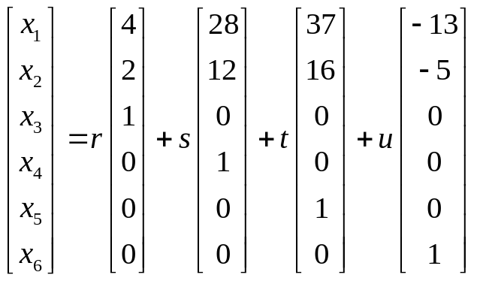
Example 1
Rank and Nullity of a 4×6 Matrix (2/2)
The corresponding system of equations will be
x₁-4x₃-28x₄-37x₅+13x₆=0
x₂-2x₃-12x₄-16x₅+5x₆=0
It follows that the general solution of the system is
x₁=4r+28s+37t-13u; x₂=2r+12s+16t-5u; x₃=r; x₄=s; x₅=t; x₆=u
Or
So that nullity(A)=4.

Slide 65
Theorem 5.6.2
If A is any matrix, then rank(A)= rank(A^{T}).

Slide 66
Theorem 5.6.3
Dimension Theorem for Matrices
If A is a matrix with n columns, then
rank(A)+nullity(A)=n

Slide 67
Theorem 5.6.4
If A is an m×n matrix, then:
rank(A)=the number of leading variables in the solution of Ax=0.
nullity(A)=the number of parameters in the general solution of Ax=0.

Slide 68
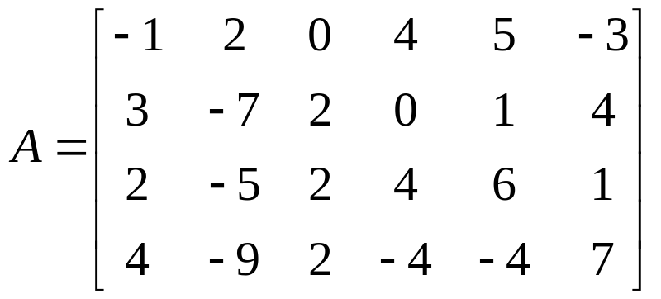
Example 2
The Sum of Rank and Nullity
The matrix
has 6 columns, so
rank(A)+nullity(A)=6
This is consistent with Example 1, where we should showed that
rank(A)=2 and nullity(A)=4

Slide 69
Example 3
Find the number of Parameters in a General Solution
Find the number of parameters in the general solution of Ax=0 if A is a 5×7 matrix of rank 3.
Solution.
nullity(A)=n-rank(A)=7-3=4
Thus, there are four parameters.

Slide 70
Maximum Value for Rank
If A is an m×n matrix, then the row vectors lie in R^{n} and the column vectors lie in R^{m}. This implies that the row space of A is at most n-dimensional and that the column space is at most m-dimensional. Since the row and column space have the same dimension (the rank A), we must conclude that if m≠n, then the rank of A is at most the smaller of the values of m or n. We denote this by writing
rank(A)≦min(m, n)
where min(m, n) denotes the smaller of the numbers m and n if m≠n or their common value if m＝n.

Slide 71
Example 4
Maximum Value of Rank for 7×4 Matrix
If A is a 7×4 matrix, then the rank of A is at most 4 and , consequently, the seven row vectors must be linearly dependent. If A is a 4×7 matrix, then again the rank of A is at most 4 and, consequently, the seven column vectors must be linearly dependent.

Slide 72
Theorem 5.6.5
The Consistency Theorem
If Ax=b is a linear system of m equations in n unknowns, then the following are equivalent.
Ax=b is consistent.
b is in the column space of A.
The coefficient matrix A and the augmented matrix [A|b] have the same rank.

Slide 73
Theorem 5.6.6
If Ax=b is a linear system of m equations in n unknowns, then the following are equivalent.
Ax=b is consistent for every m×1 matrix b.
The column vectors of A span R^{m}.
rank(A)=m.

Slide 74
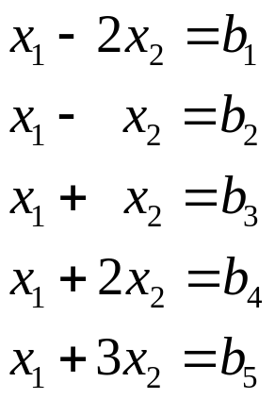
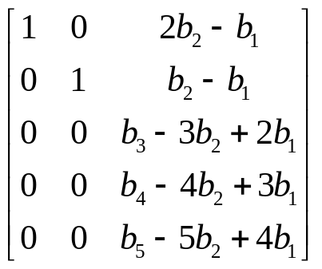
Example 5
An Overdetermined System (1/2)
The linear system
is overdetermined, so it cannot be consistent for all possible values of b₁, b₂, b₃, b₄, and b₅. Exact conditions under which the system is consistent can be obtained by solving the linear system by Gauss-Jordan elimination.

Slide 75
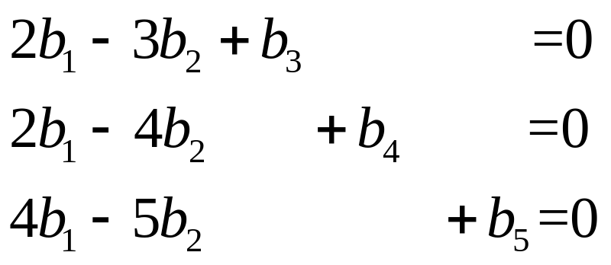
Example 5
An Overdetermined System (2/2)
Thus, the system is consistent if and only if b₁, b₂, b₃, b₄, and b₅ satisfy the conditions
or, on solving this homogeneous linear system,
b₁=5r-4s, b₂=4r-3s, b₃=2r-s, b₄=r, b₅=s
where r and s are arbitrary.

Slide 76
Theorem 5.6.7
If Ax=b is consistent linear system of m equations in n unknowns, and if A has rank r, then the general solution of the system contains n-r parameters.

Slide 77
Example 6
Number of Parameters in a General Solution
If A is a 5×7 matrix with rank 4, and if Ax=b is a consistent linear system, then the general solution of the system contains 7-4=3 parameters.

Slide 78
Theorem 5.6.8
If A is an m×n matrix, then the following are equivalent.
Ax=0 has only the trivial solution.
The column vectors of A are linearly independent.
Ax=b has at most one solution (none or one) for every m×1 matrix b.

Slide 79
Example 7
An Undetermined System
If A is a 5×7 matrix, then for every 7×1 matrix b, the linear system Ax=b is undetermined. Thus, Ax=b must be consistent for some b, and for each such b the general solution must have 7-r parameters, where r is the rank of A.

Slide 80
Theorem 5.6.9
Equivalent Statements (1/2)
If A is an m×n matrix, and if T_{A}:R^{n}→R^{n} is multiplication by A, then the following are equivalent.
A is invertible.
Ax=0 has only the trivial solution.
The reduced row-echelon form of A is I_{n}.
A is expressible as a product of elementary matrices.
Ax=b is consistent for every n×1 matrix b.
Ax=b has exactly one solution for every n×1 matrix b.
det(A)≠0.

Slide 81
Theorem 5.6.9
Equivalent Statements (2/2)
The range of T_{A} is R^{n}.
T_{A} is one-to-one.
The column vectors of A are linearly independent.
The row vectors of A are linearly independent.
The column vectors of A span R^{n}.
The row vectors of A span R^{n}.
The column vectors of A form a basis for R^{n}.
The row vectors of A form a basis for R^{n}.
A has rank n.
A has nullity 0.

